Slide 1
First Article Inspection (Report) EXPLAINED
PPAP / FAI / FAIR
Form #: TR-004 Uncontrolled if Printed Date: 6/3/2021
Rev.: A Owner: Quality

Slide 2
DEFINITION
A First Article Inspection Report (FAIR) is a formal method of providing a measurement report for a given manufacturing process. The method consists of measuring of an initial sample item against given specifications, for example a drawing.
A First Article Inspection (FAI) is a design verification and history file with a formal method of providing a reported measurement for a given manufacturing process. Both the supplier and purchaser perform the First Article on the ordered product.
Form #: TR-004 Uncontrolled if Printed Date: 6/3/2021
Rev.: A Owner: Quality

Slide 3
Information
First Article Inspection is a unique standard (AS9102 Rev B) and not part of the AS9100 Rev C QMS. However, Section 8.3.5 Design & Development Output of the standard does require testing of a production part, which is basically the same as FAI.
The FAI report certifies that each “sample” unit was produced and inspected according to the customers’ specifications, and includes all physical, material, and chemical test data relative to the part specification.
Production Part Approval Process (PPAP) is used in the automotive supply chain for establishing confidence in suppliers and their production processes. Actual measurements are taken from the parts produced and are used to complete the various test sheets of PPAP.
Form #: TR-004 Uncontrolled if Printed Date: 6/3/2021
Rev.: A Owner: Quality

Slide 4
FAI / PPAP
Each FAI/PPAP must include the following:
Completed AS9102 Form 1, Form 2, & Form 3
(equivalent forms permitted)
Complete Bubbled Print
Certification of Conformance (as required)
All associated Material Certifications (as required)
All associated Special Process Certifications (as required)
All test documents/procedures
Picture of Part/Part Marking
Form #: TR-004 Uncontrolled if Printed Date: 6/3/2021
Rev.: A Owner: Quality

Slide 5
Forms
Form 1- Part Number Accountability (form FM-0021 pg.. 1)
Form 2- Product Accountability- I.E. Raw Material, Specifications, Special Processes, Functional Testing
(form FM-0021 pg.. 2)
Form 3- Characteristic Accountability (Verification and Compatibility Evaluation. (form FM-0021 pg.. 3)
Form #: TR-004 Uncontrolled if Printed Date: 6/3/2021
Rev.: A Owner: Quality

Slide 6
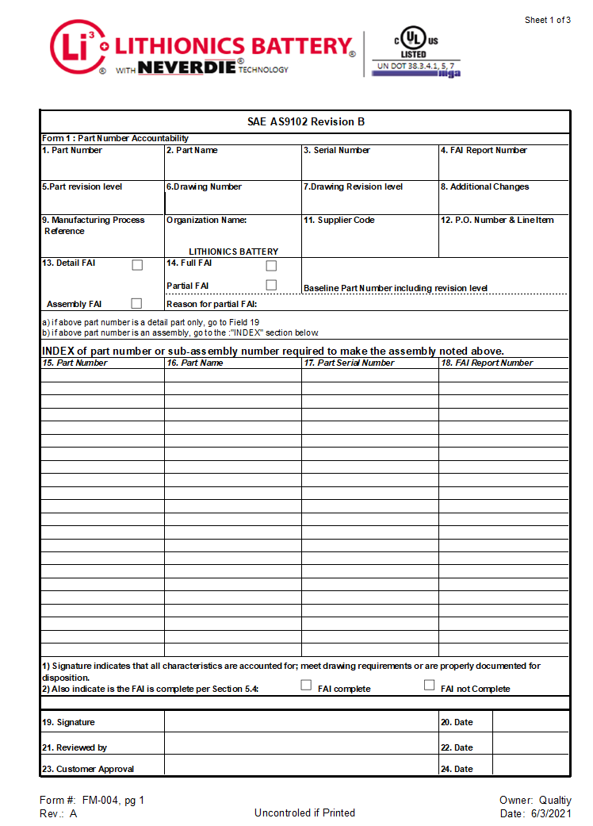
Form 1: Part Number Accountability
Form #: TR-004 Uncontrolled if Printed Date: 6/3/2021
Rev.: A Owner: Quality

Slide 7
Form 1: Part Number Accountability…..cont’d
TITLE BLOCK: Enter Rev level of the part must be inputted here including the latest ECN, if applicable. (ECN=Engineering Change Notice)
BOX #1: Part Number as ordered on Purchase Order.
BOX #2: Part Name as ordered on Purchase Order.
BOX #3: If a Serial Number exists, enter serial number of part from which actual data was measured. (If none exist enter N/A)
BOX #4: FAI Report Number input here if one exists. (Use the PO #)
BOX #5: Part Rev as on the Purchase Order.
BOX #6: If the Drawing Number should differ from the part number or tabulated drawings.
BOX #7: If the Drawing Rev Level should differ from the part rev level on the BOM.
BOX #8: Any Additional Changes to be added here.
BOX #9: Indicate the Manufacturing Process. (i.e., die #, machining, etc.)
BOX #10: Indicate the Organization Name.
BOX #11: Supplier Code, if applicable. (NA if none provided)
Form #: TR-004 Uncontrolled if Printed Date: 6/3/2021
Rev.: A Owner: Quality

Slide 8
Form 1: Part Number Accountability…..cont’d
BOX #12: P.O.# and Line Item.
BOX #13: Check appropriate box:
Detail FAI, indicates a detailed part of an assembly.
Assembly FAI, indicates the part is a final assembly.
BOX #14: Check appropriate box:
Full FAI, indicates Full FAI procedure to be completed.
Partial FAI, typically indicates a rev change or part was previously disqualified.
(A subsequent delta FAI is needed to verify that dimensions or attributes that were previously rejected, now conform).
NOTE: a) if above part number is a detail part only, go to BOX #19
b) if above part number is an assembly, go to INDEX
INDEX: Part # or Sub-assembly # required to make the assembly noted above.
BOX #15: Part Numbers listed for the components that were used to complete the part number listed in section 1.
BOX #16: Part Name associated with the part number in section 15.
BOX #17: Serial Number associated with the part number in section 15, if applicable.
Form #: TR-004 Uncontrolled if Printed Date: 6/3/2021
Rev.: A Owner: Quality

Slide 9
Form 1: Part Number Accountability…..cont’d
BOX #18: FAI Report Number referencing the completed sub-assembly FAI report on the listed part in section 15. (This section allows for traceability should a sub-assembly part ever be determined to be defective or non-conforming).
NOTE: 1) Signature indicates that all characteristics are accounted for; meet drawing requirements or are properly documented for disposition.
2) Also, indicate that the FAI is complete per Section 5.4:
Check appropriate Box: FAI Complete or FAI Not Complete
(Note: No FAI submitted should be an Incomplete FAI)
BOX #19: Signature of the appropriate personnel who prepared the FAI testifying that all information is true and accurate.
BOX #20: Date that the author signed the form.
BOX #21: Signature by Q.A. Manager or 2nd person validation that verifies the FAI is complete and accurate. This is not required, but it is a best practice.
BOX #22: Date reviewed, if applicable.
BOX #23: Customer Approval signature, if required.
BOX #24: Date the FAI was approved by the Customer, if required.
Form #: TR-004 Uncontrolled if Printed Date: 6/3/2021
Rev.: A Owner: Quality

Slide 10
Form 2: Product Accountability
Form #: TR-004 Uncontrolled if Printed Date: 6/3/2021
Rev.: A Owner: Quality

Slide 11
Form 2: Product Accountability…..cont’d
TITLE BLOCK: Same as Form #1
BOX #1: Part Number as ordered on Purchase Order.
BOX #2: Part Name as ordered on Purchase Order.
BOX #3: If a Serial Number exists, enter serial number of part from which actual data was measured. (If none exist enter N/A)
BOX #4: FAI Report Number input here if one exists. (use the PO #)
BOX #5: Materials or Processes (i.e., chem. film, paint, heat treat, etc…) used to manufacture the part. (N/A if it does not apply)
BOX #6: Specification Number used to process material listed in section 5 (i.e., chem. Film -> Mil-DTL-5541F). Spec and Rev Levels are appreciated with the spec number but are not a requirement. (N/A if it does not apply)
BOX #7: Code is used to in association with the proper material or processes listed in section 5. (N/A if it does not apply)
BOX #8: Special Process Supplier Code is used for varication. (N/A if it does not apply)
Form #: TR-004 Uncontrolled if Printed Date: 6/3/2021
Rev.: A Owner: Quality

Slide 12
Form 2: Product Accountability…..cont’d
***Verify that the Special Process Suppliers are approved for the processes being preformed***
BOX #9: Customer Approval Verification. (Yes, No, N.A.)
BOX #10: Certificate of Conformance Number to be listed here, if COC is not numbered the supplier shall assign a distinct number. (N/A if it does not supply)
BOX #11: Functional Test Procedure Number to reference acceptance report for each test provided in section 11. (N/A if it does not apply)
BOX #12: Acceptance Report Number, if applicable.
BOX #13: Any general or specific Comments regarding the part or FAI.
BOX #14: Signature of the appropriate personnel who prepared the FAI testifying that all information is true and accurate.
BOX #15: Date that the author signed the form.
Form #: TR-004 Uncontrolled if Printed Date: 6/3/2021
Rev.: A Owner: Quality

Slide 13
Form 3: Characteristic Accountability, Verification and Compatibility Evaluation
Form #: TR-004 Uncontrolled if Printed Date: 6/3/2021
Rev.: A Owner: Quality

Slide 14
Form 3: Characteristic Accountability, Verification and Compatibility Evaluation…..cont’d
TITLE BLOCK: Same as Form #1
BOX #1: Part Number as ordered on Purchase Order.
BOX #2: Part Name as ordered on Purchase Order.
BOX #3: If a Serial Number exists, enter serial number of part from which actual data was measured. (If none exist enter N/A)
BOX #4: FAI Report Number input here if one exists. (use the PO #)
BOX #5: Character Numbers Identified on Bubble Drawing
Starting with numbered tables for any (Items/Notes/Features) identified in the Bubble Drawing. List these in sequential order down the column (i.e., 1,2,3). Any table thereafter is to continue using the next number in sequence (i.e., if you ended the last table on bubbled 3, then continue with 4,5,6).
Continue Identifying (Dimensions and Features) by numbering each, Starting at the Bottom Left and continuing Clockwise around the Print. Any Number used when Identifying the Print is to continue using the next number in sequence (i.e., if you ended the last table on bubbled 6, then continue with 7,8,9).
BOX #6: The Reference Location is identified by a border reference using Letters and Numbers. (I.E., by referencing the Letter and Number that intersects a note or detail being explained on the Bubbled Drawing)
BOX #7: Characteristic Designator identifies symbols or details used to feature characteristics of that item. (I.E., Tolerance, Diameter, Flatness, Wire Diagrams, Packaging, etc.)
Form #: TR-004 Uncontrolled if Printed Date: 6/3/2021
Rev.: A Owner: Quality

Slide 15
Form 3: Characteristic Accountability, Verification and Compatibility Evaluation…..cont’d
BOX #8: Requirement for a featured dimension on a drawing must include Tolerances.
Under no circumstances should a dimension be listed without a tolerance unless the feature is a basic or geometric tolerance.
Features that do not have specific dimensions but are governed by the tolerance listed in the title block must have the tolerances listed with the feature.
BOX #9: Results of the measurement should be listed in this section.
BOX #10: Designed/Qualified Tooling only to be listed in this section. (i.e., special fixtures, issued measuring tools and gages, etc.)
BOX #11: Non-Conformance Number to be added here if any features do not meet spec.
(This becomes a mandatory field if the part has any nonconformances)
BOX #12: Signature of the appropriate personnel that prepared. This indicates all characteristics are accounted for, meet drawing requirements or are properly documented for disposition.
BOX #13: Date when the report was signed.
BOX #14: Approval Data/Comments comments detailing features the customer should be aware of.
Form #: TR-004 Uncontrolled if Printed Date: 6/3/2021
Rev.: A Owner: Quality

Slide 16
Bubbled Drawing Example

Slide 17
Bubbled/Balloon Drawing…..Cont’d
Start:
Items and/or notes table identified, is to be numbered first. (I.E., B.O.M. items, etc.)
Starting at the bottom left of the drawing circle Clockwise direction indicating all features and dimensions. (Include any Tables, Wire Diagrams and Tolerance Block as STAY CONSTISTENT when Numbering Drawing/Prints.
All notes must be spelled, out exactly like the Drawing/Print shows, NO Alterations or Abbreviations can be accepted.
Form #: TR-004 Uncontrolled if Printed Date: 6/3/2021
Rev.: A Owner: Quality

